Slide 1
Practical Advice for Next Generation Sequencing (NGS)
Anoja Perera (agp@stowers.org)
Director, Sequencing and Discovery Genomics
Stowers Institute for Medical Research

Slide 2

Agenda
Introduction to NGS
Long-Read Sequencing
Short-Read Sequencing
Data Quality Assessment
Single Cell Sequencing
Spatial Transcriptomics

Slide 3
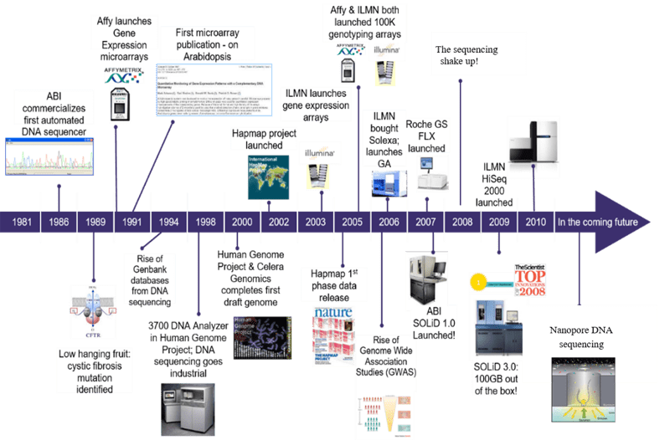
A Quick History
Cheap sequencing!
Single cell Sequencing
Spatial Transcriptomics
…

Slide 4
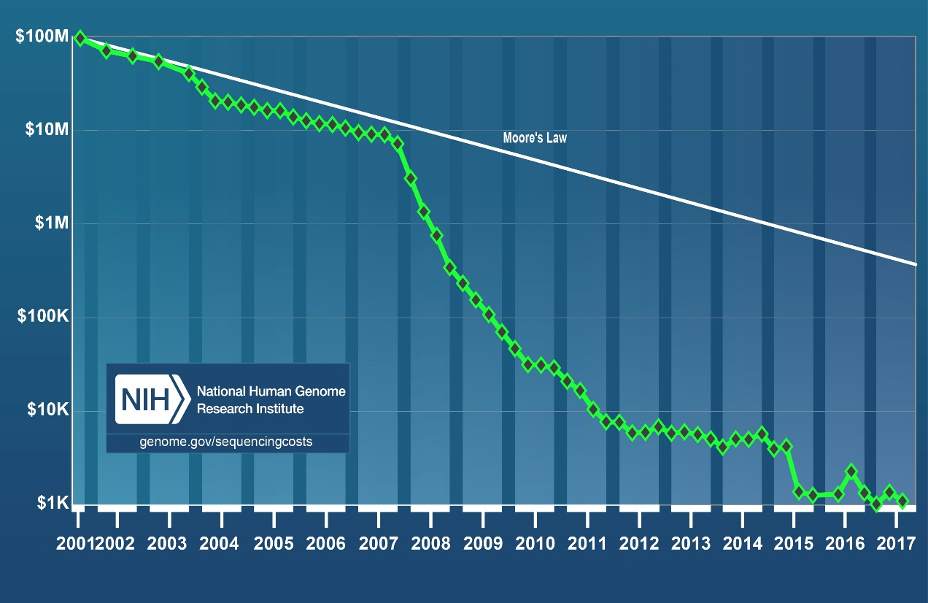
Cost per Human Genome
Source: National Human Genome Research Institute
Notes:
Figure 1: The cost of sequencing a single human genome from 2001 to 2020. The graph shows that the cost of sequencing per human genome has consistently been lower than predicted by Moore’s Law in 2008. Image credit: National Human Genome Research Institute

Slide 5
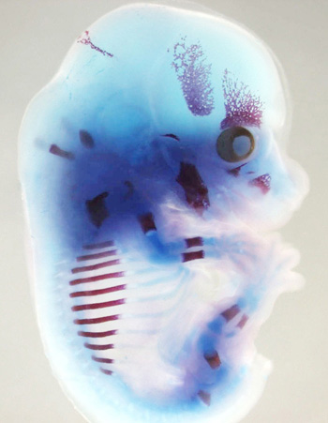
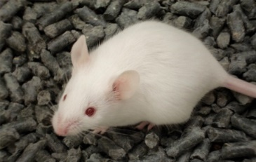
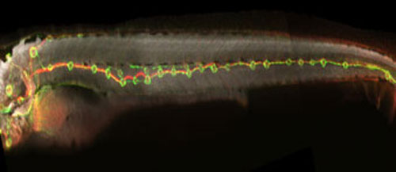
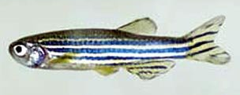
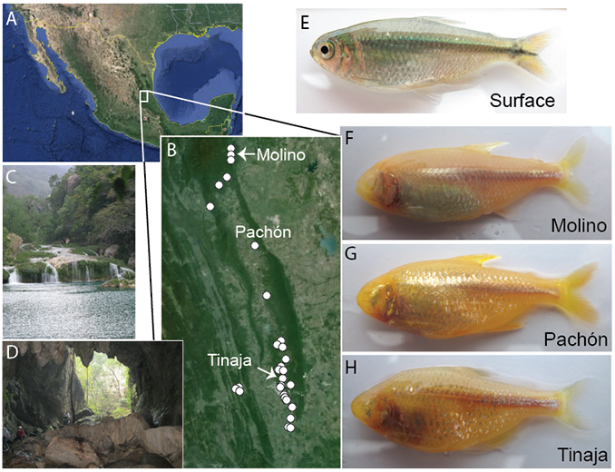
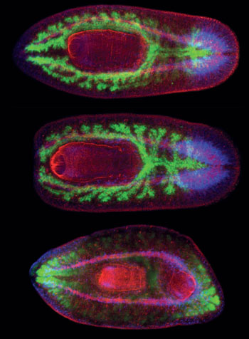
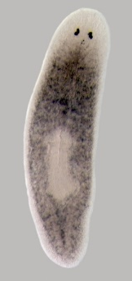
Examples of Research at Stowers Institute
Zebrafish sensory system similar to human inner ear
Craniofacial development in mouse embryos
Stem cell regeneration in planaria
Metabolism in different species of cavefish

Slide 6
Pros and Cons of Long-Read data
Pros
Direct sequencing of libraries without amplification
Determination of base modifications such as methylated bases
Aids in de novo assembly by spanning low complexity and repetitive regions
Assists in determining haplotypes, structural variations, indels etc.
Can obtain full length transcript information and hence aid isoform discovery
Cons
Costly
Slow

Slide 7

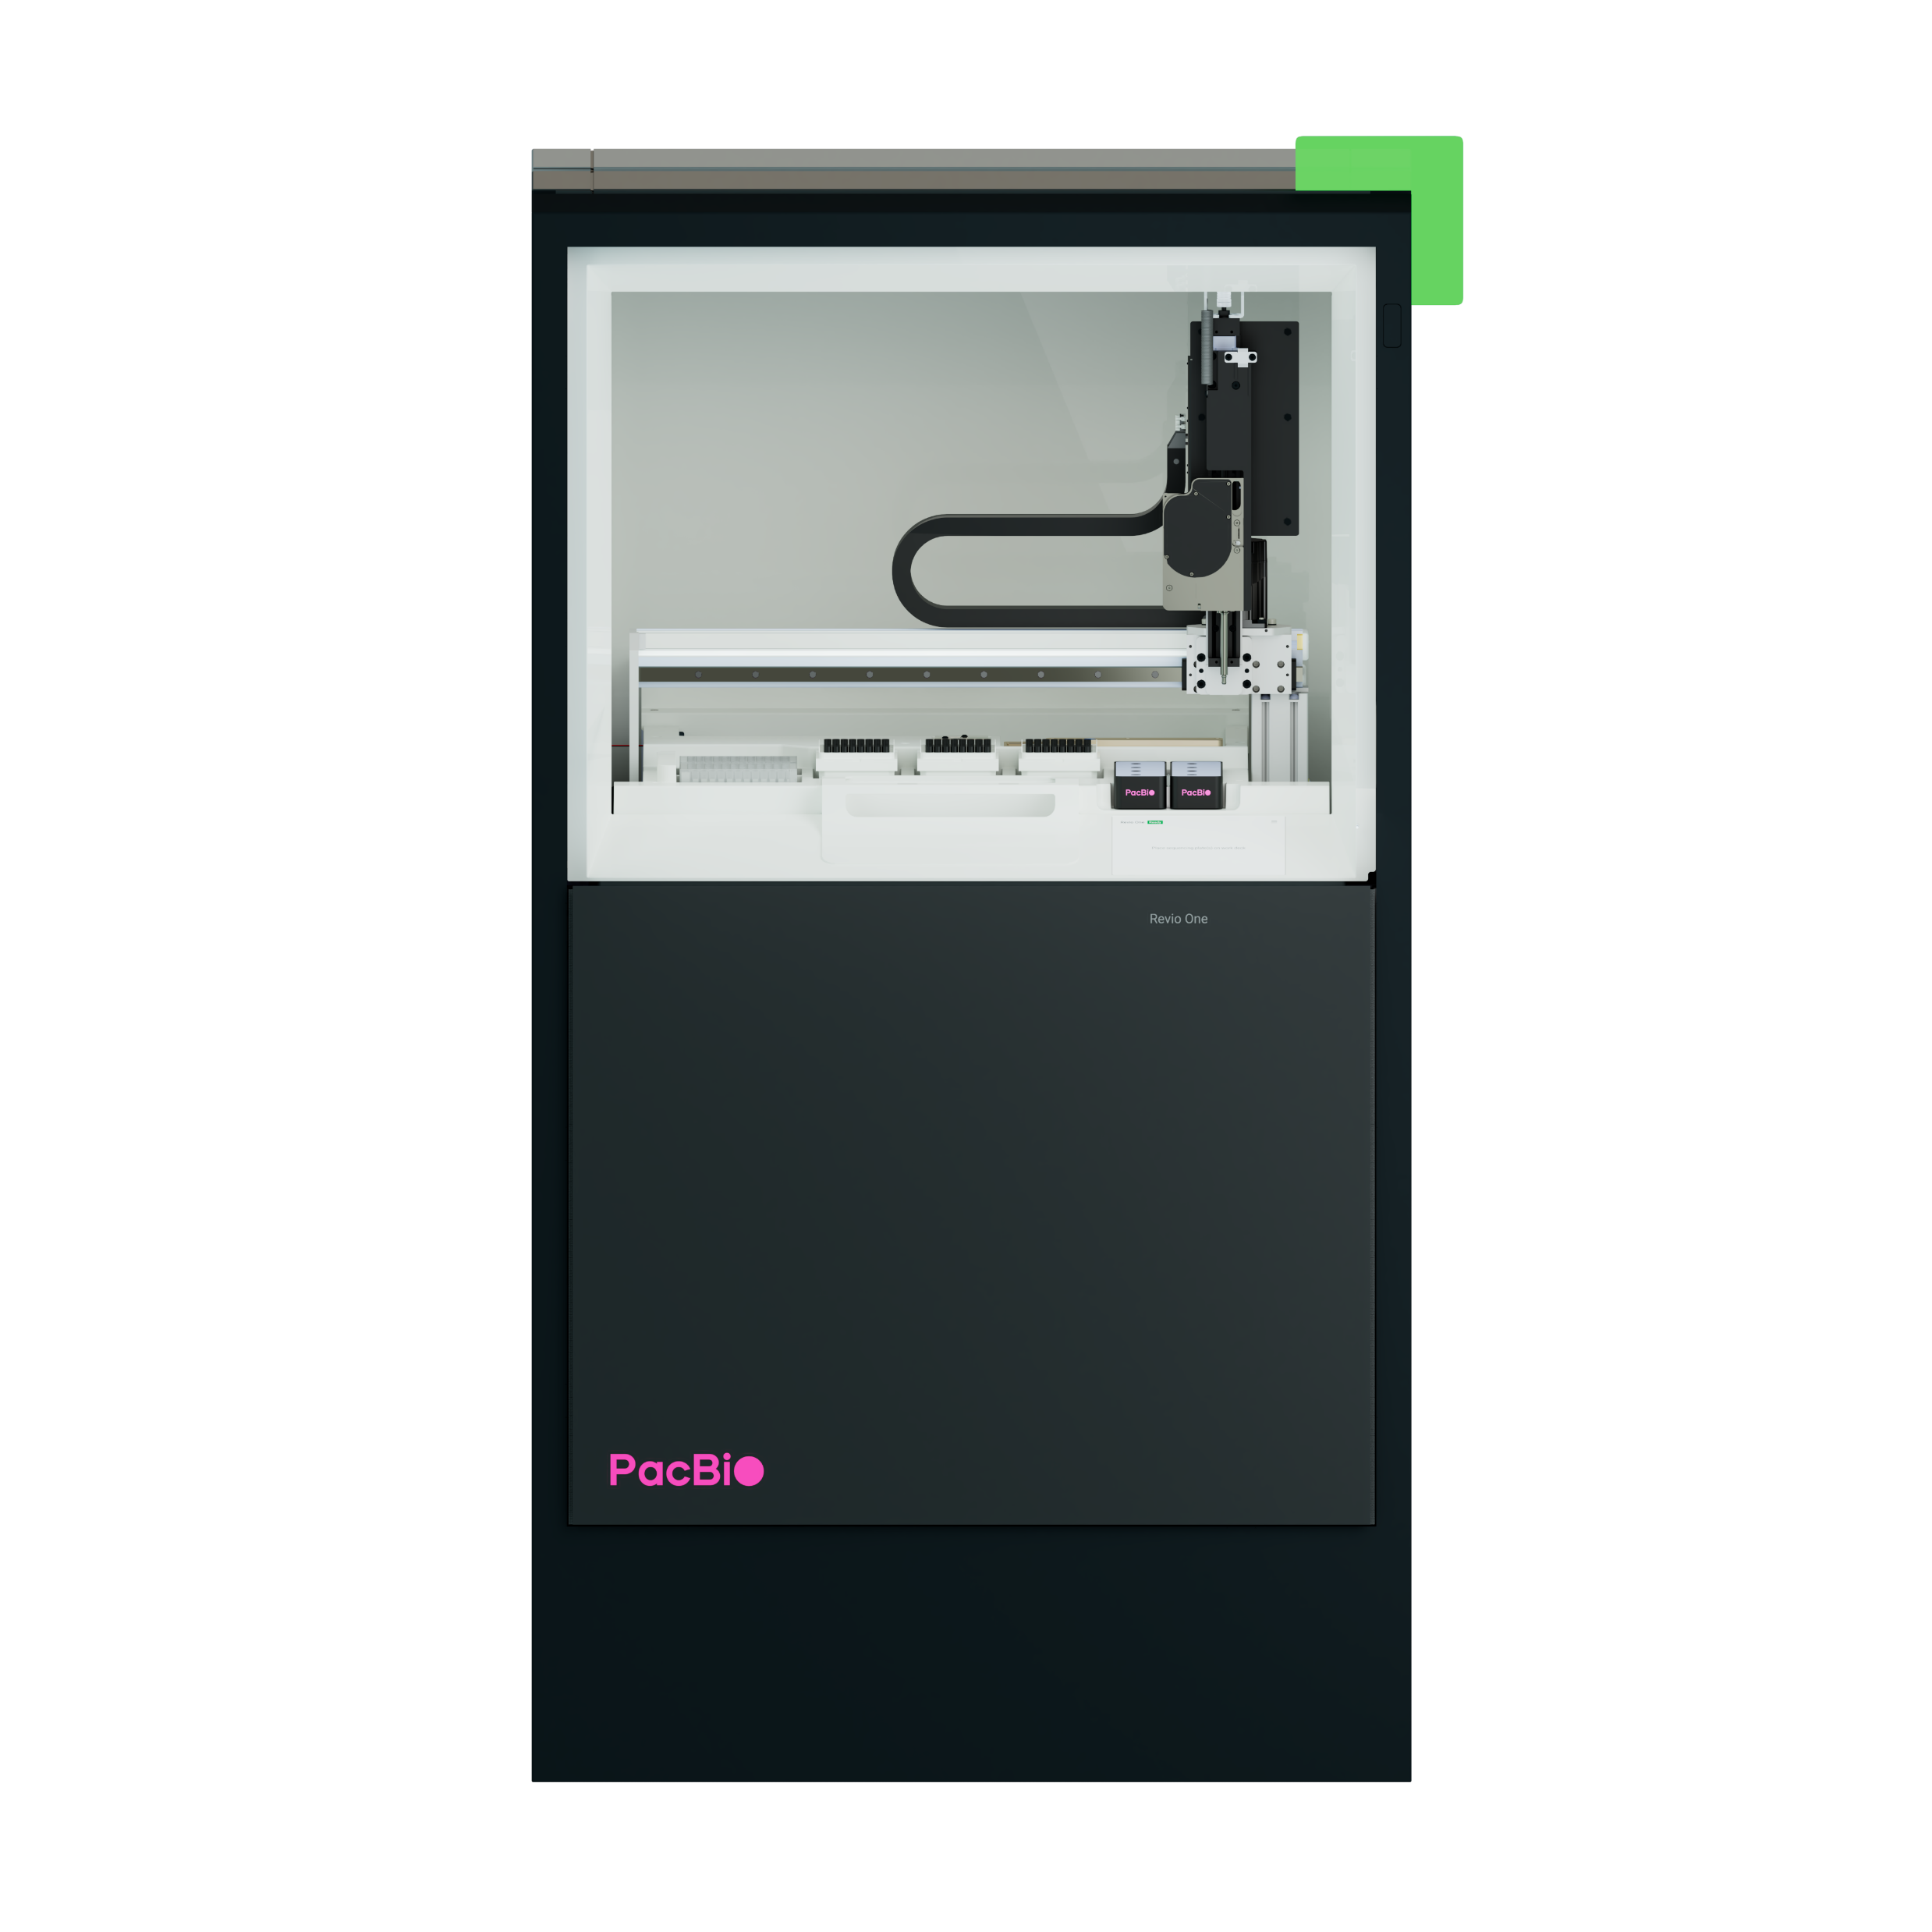
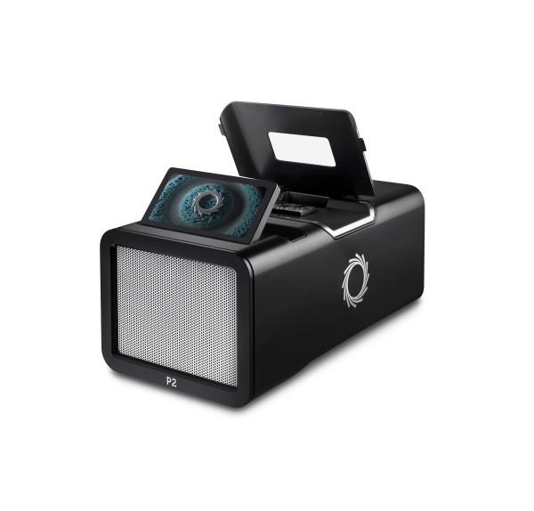
Long Reads Sequencing at Stowers
PacBio Revio
Whole Genome Sequencing and Assembly
Structural Variation Detection
Methylation Detection
Isoform Discovery
Full length cDNA Sequencing
Metagenomics
Amplicon Sequencing
PacBio Sequencing – How it Works - Bing video
Oxford Nanopore P2i
Whole Genome Sequencing and Assembly with Extra Long Reads
Structural Variation Detection
Methylation Detection
Isoform Discovery
Full length cDNA Sequencing
Metagenomics
Amplicon Sequencing
Plus, Direct RNA Sequencing

Slide 8
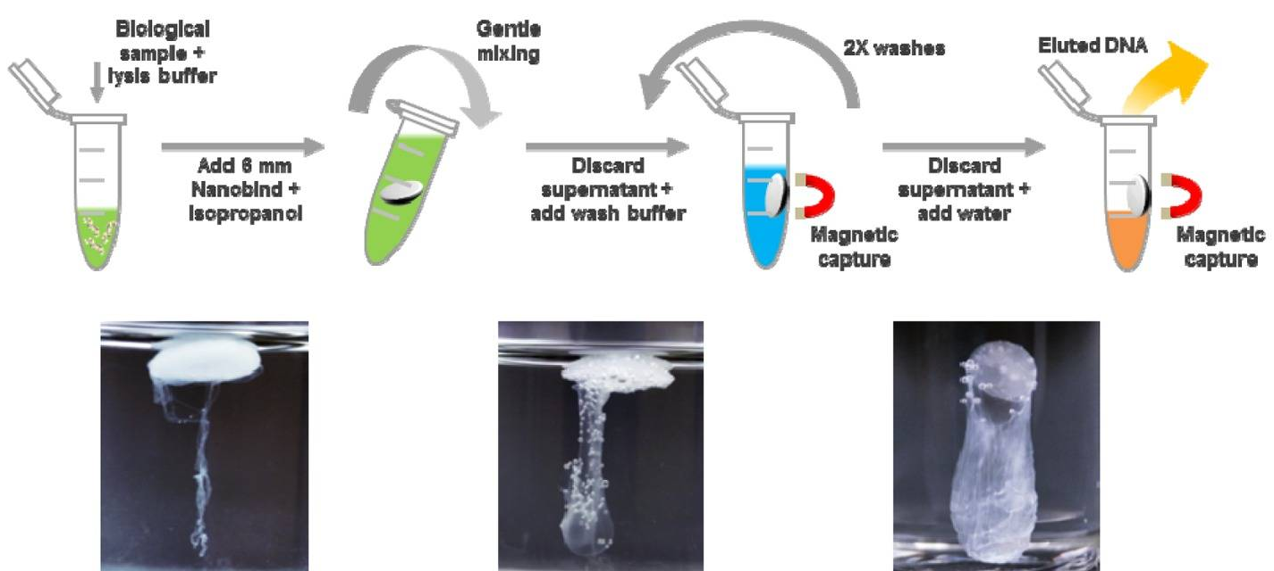
Key to long read sequencing: HMW DNA!
1. PacBio/Circulomics
2. NEB Monarch Kits work great!

Slide 9
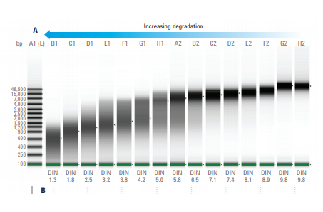
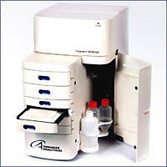
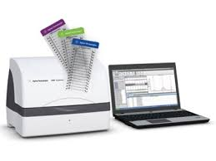
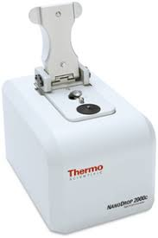
Long Reads Best Practices
Start with HMW DNA (Circulomics and NEB Manarch are good products!)
Quantification and Quality Checks of starting materials are critical. It might be difficult to get accurate quantification of HMW DNA.
Avoid vortexing, pipette slowly using wide bore tips
Check for impurities via Nanodrop. 260 nm: 280 nm of ~1.8 is accepted as “pure” DNA; a ratio of ~2.0 is accepted as “pure” RNA. If the ratio is lower in either case, it may indicate the presence of protein, phenol or other contaminants that absorb strongly at or near 280 nm.
Advanced Analytical Femto
Agilent Tape Station
Thermo Nanodrop

Slide 10
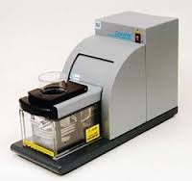
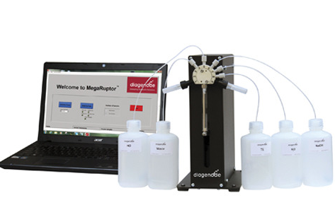
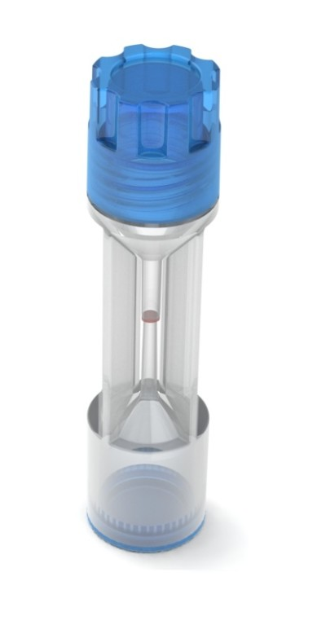
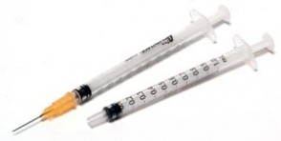
Physical / Mechanical Shearing
Method | Time | DNA Input | Fragment Length
Covaris Ultrasonicator | ~ 1 min | Up to 5 µg | 100 bp – 5 kb
Covaris g-Tube | 10 min | ~ 10 µg | 6 – 20 kb
Needle Shearing | 20 min | 2 – 10 µg | > 30 kb
Diagenode Megaruptor | 10 – 20 min | Up to 8 µg | 2 – 75 kb
Images © 2018 Pacific Biosciences of California, Inc. All rights reserved.

Slide 11
Oxford Nanopore Sequencing (ONT)
Additional Pros:
No limitations in length of molecules that can be sequenced (>2 Mb)
Capable of measuring DNA, RNA, protein, and modifications
Can be used for unique applications such as pathogen detection, plasmid sequencing, full length amplicon sequencing
Active community improving and developing protocols
Some platforms (Fongle, MinION) are portable!
Additional Cons:
Protocols are often not standardized
Getting consistent output per flowcell is impossible!
Notes:
Please note video

Slide 12
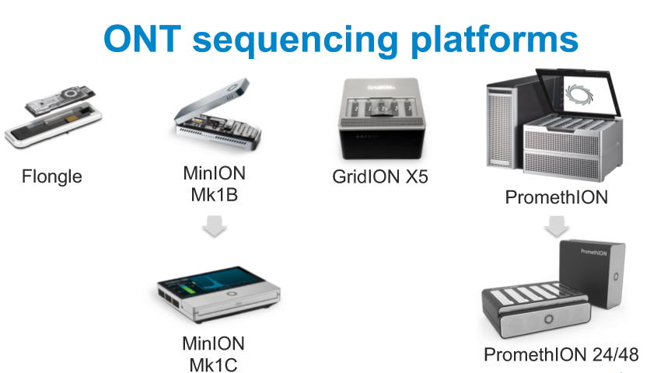
Oxford Nanopore Sequencing
https://binged.it/3EG0dB7

Slide 13
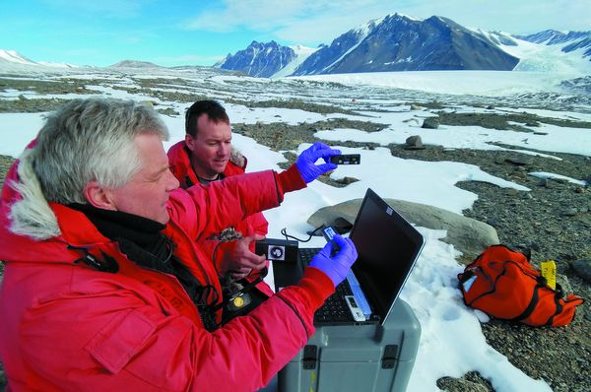
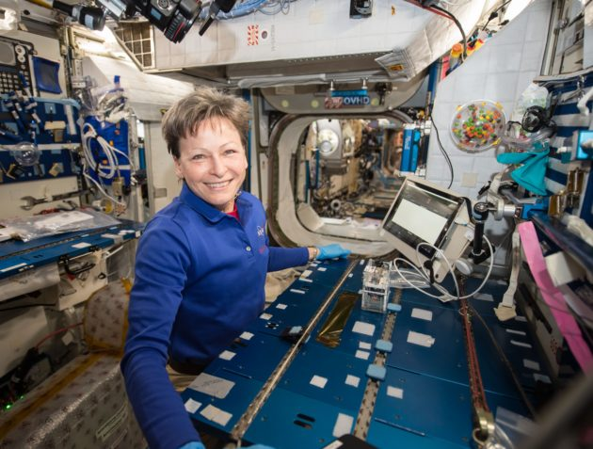
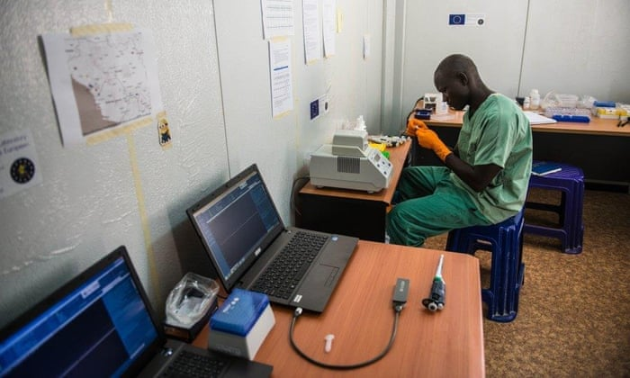
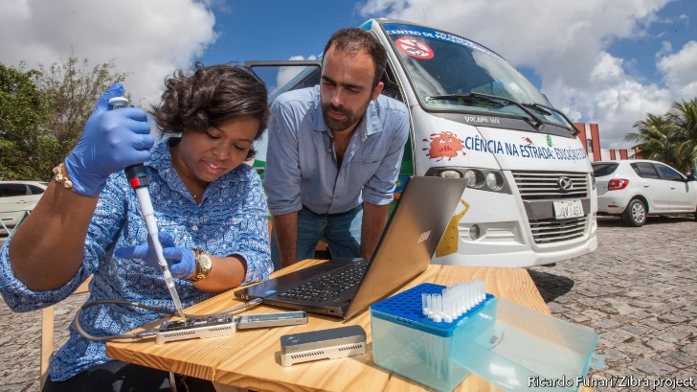
Oxford Nanopore Sequencing in the Field
Sequencing microbial DNA in Antarctica
NASA astronaut sequencing bacteria in space
Sequencing Ebola virus in Guinea
Sequencing Zika virus in Brazil

Slide 14
Pros and Cons of Short-Read data
Pros
Cost per base is significantly lower than long-reads methods
Great for counting applications such as Chromatin Immunoprecipitation Sequencing (ChIP-Seq) or gene expression studies such as RNA-Seq
Due to accuracy, for variant calling
Fast data generation
More established pipelines for data analysis
Many supported and published applications
Cons
PCR bias introduced by amplification
Difficulty sequencing high GC regions
Difficulty in resolving substitution, deletions, duplications, haplotypes, palindromic and repetitive regions
Bias towards smaller fragments

Slide 15
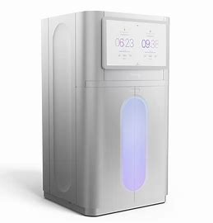
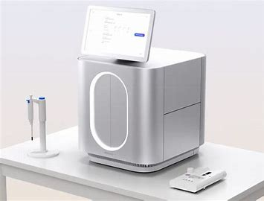
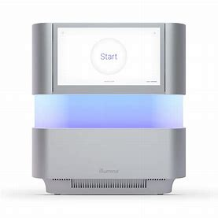
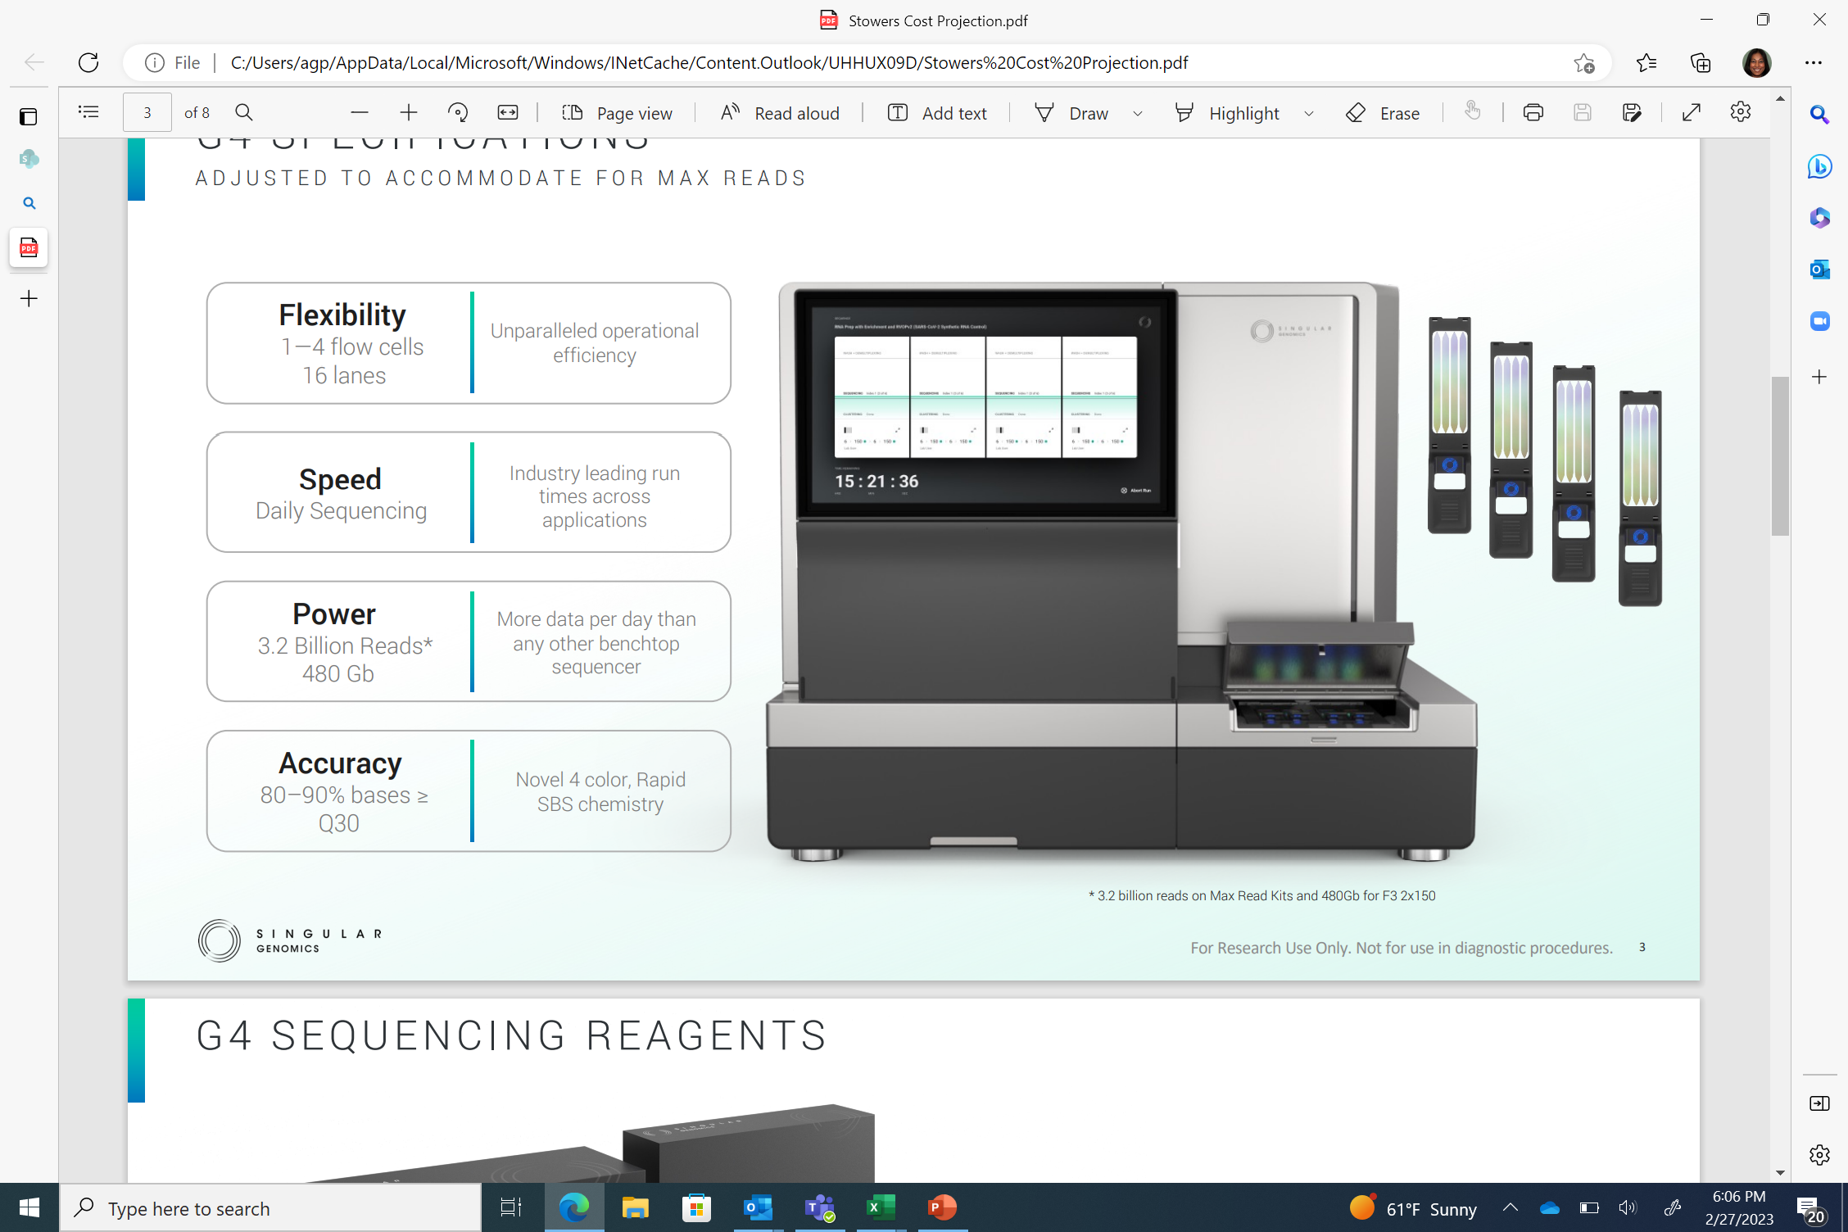
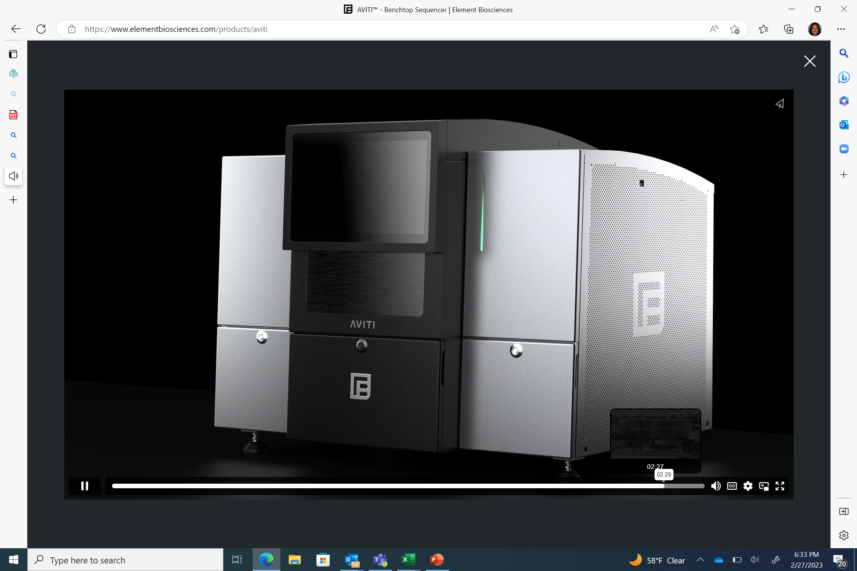
Short Reads Capabilities at Stowers Institute
Illumina NovaSeq X Plus (Through Kansas University Medical Center)
Illumina i100*
Illumina NextSeq 2000
Singular G4
Element AVITI
* Not Available Yet

Slide 16
Some Common Short Reads Applications
Whole Genome Sequencing
Exome Se quenching
Amplicon Sequencing
Metagenomics
16s Sequencing
Methylation detection
Ribosome Profiling
Chromatin Immunoprecipitation
Trancriptome sequencing
Small/micro RNA sequencing
Sequencing for single cell applications
…

Slide 17
Workflow for NGS
Sample Preparation
Library Construction
Sequencing
Data Analysis

Slide 18
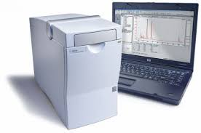
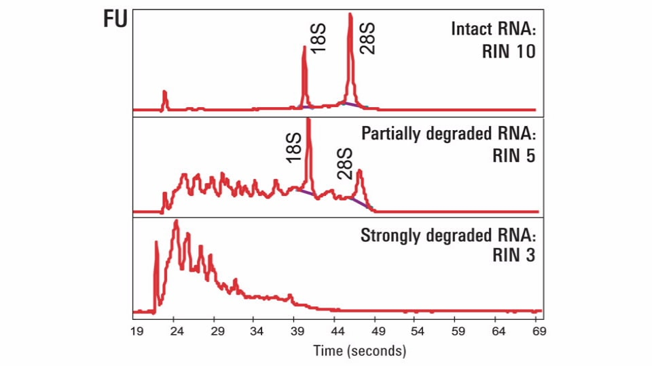
Sample Preparation for Short Read Sequencing
Good starting material is critical! Extract best quality DNA or RNA
Many commercial kits available. NEB, Qiagen, Zymo, Promega etc.
Some bead-based extraction methods make it easy to automate
Check for quality and purity
Many instruments available. Thermo Nanodrop, Thermo Qubit Fluorometer, Agilent Bioanalyzer, Agilent Tape Station, Revvity Fragment Analyzer
Agilent Bioanalyzer System

Slide 19
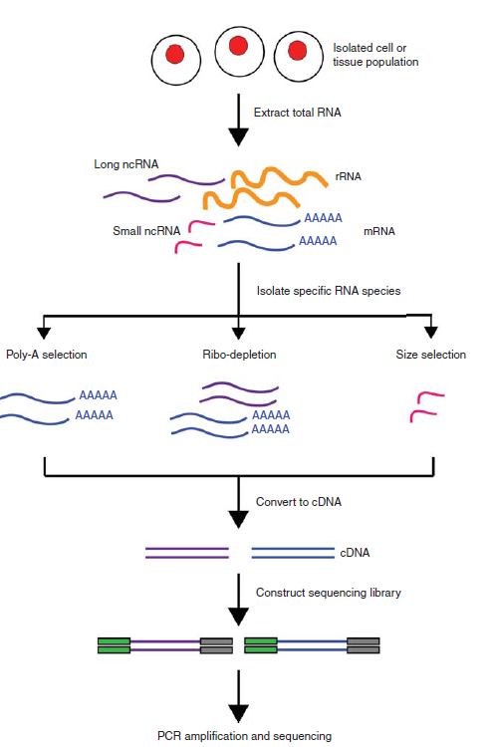
Library Construction (RNA)
Always check the integrity of RNA before starting
Depending on the type of RNA interested, different protocols available.
smallRNA sequencing, mRNA sequencing, total RNA (ribodepleted) sequencing…
Have replicates! At least three biological replicates recommended.
Many RNA kits in the market and some kits work better than others depending on what is needed.
We routinely use Watchmaker for library construction
For larger projects we miniaturize reaction 1/5 or 1/10
For starting amounts less than 1ng or starting directly from lysed cells, we use Takara SMARTer
For degraded RNA, avoid poly-A selection and do ribodepletion.
Most ribodepletion kits support Human, Mouse and Rat only. Companies like Qiagen have additional depletion kits.
Perform quality checks prior to sequencing

Slide 20
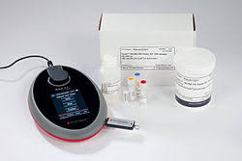
Library QC
Quality of libraries is a good indication of how your data will look.
qPCR will help you quantify fragments that are “sequence-able”
Quantity assessment via Invitrogen Qubit Fluorometer
Agilent Bioanalyzer, Tape Station, and Revvity Fragment Analyzer are good for quality determination as they provide size of fragments, presence of adapter dimer, overamplification etc.
Invitrogen Qubit Fluorometer
Agilent Bioanalyzer System
Notes:
!!!!

Slide 21
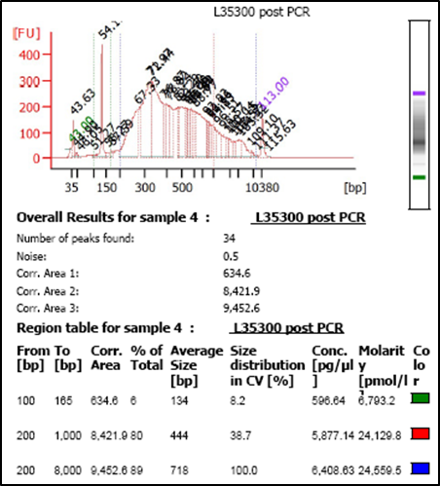
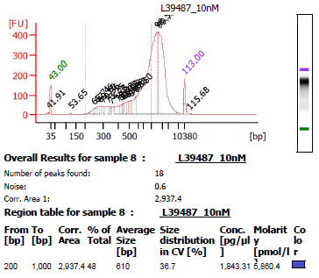
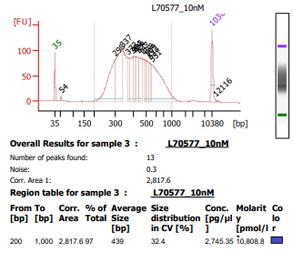
Good vs. Ugly Libraries
A
B
C
Good Library
Larger Fragments, not suitable for short read Sequencing
Adapter Dimer

Slide 22
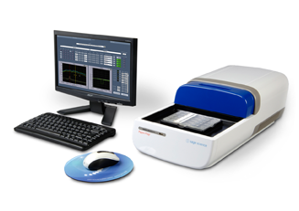
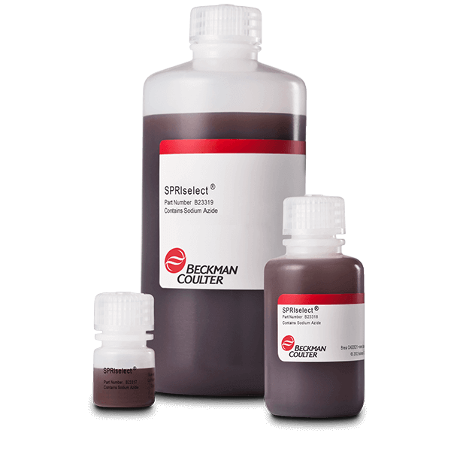
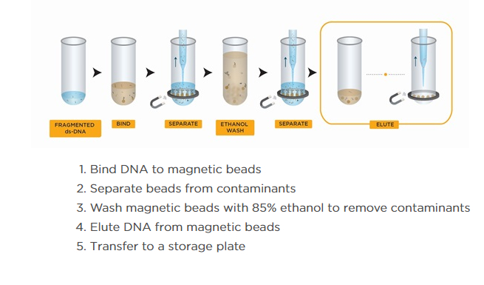
Library Size Selection
Two popular methods of size selection:
Sage Sciences’ automated instruments
Bead based size selection
Size selection is done to:
get rid of adapter sequences
get fragments in the proper size range for sequencing
Sage Science’s Blue Pippin
Beckman Coulter’s SPRI Select beads

Slide 23
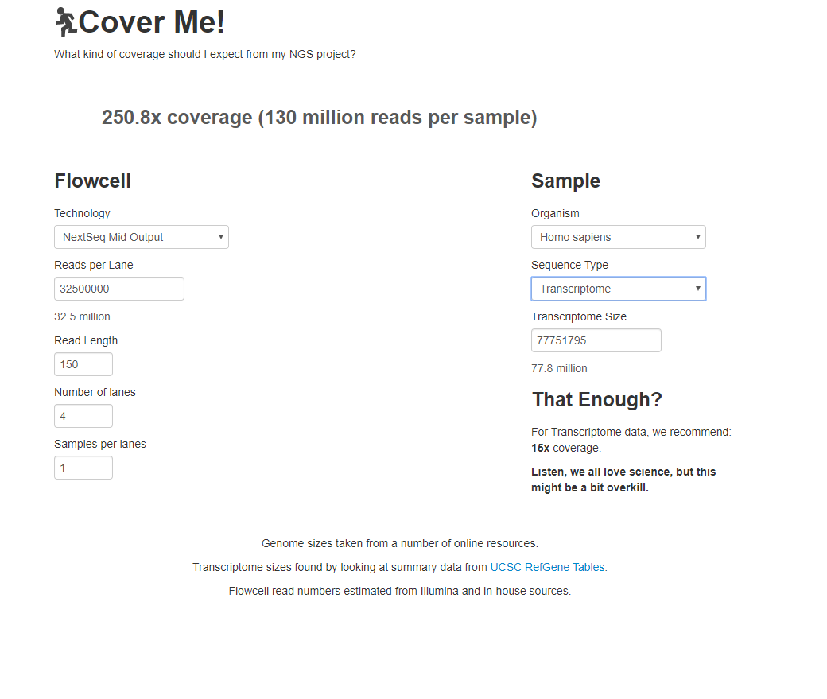
How Much to Sequence?
Amount of sequencing needed will depend on many things; organism, application, starting material, instrument used etc.
http://metalhelix.github.io/coverme/

Slide 24
Post Sequencing Quality Checks

Slide 25
Primary Analysis and QC checks
Read counts per index/library
Index accuracy
Alignment
Contaminations
Quality of reads
Contamination
Other (RNA-specific checks)

Slide 26
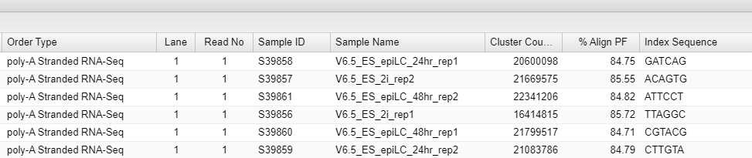
Read Counts and Alignments

Slide 27
Read Counts and Alignments

Slide 28
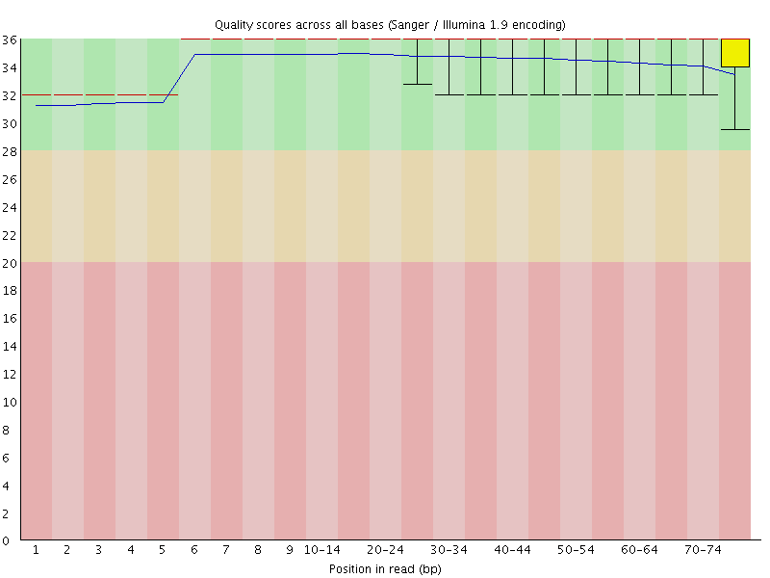
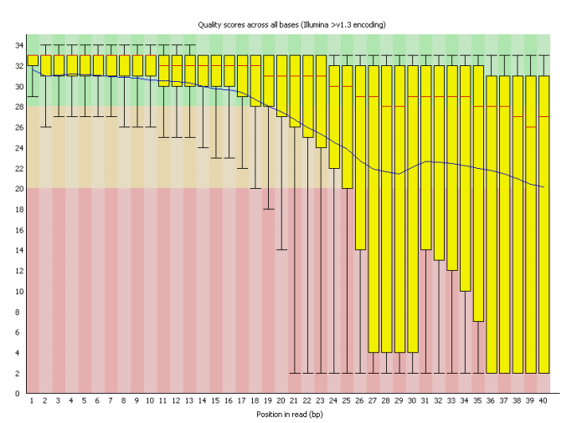


Per Base Sequence Quality

Slide 29
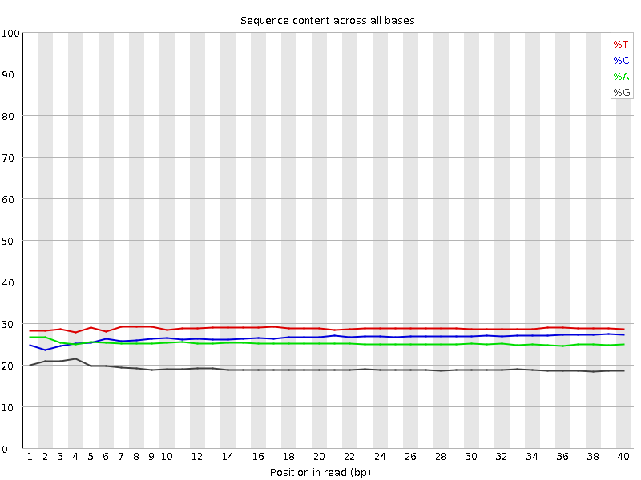
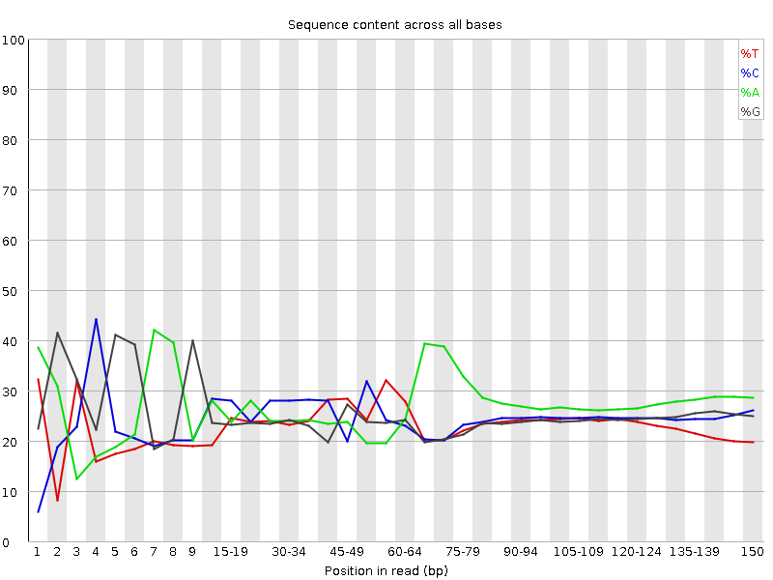
Per Base Sequence Content

Slide 30
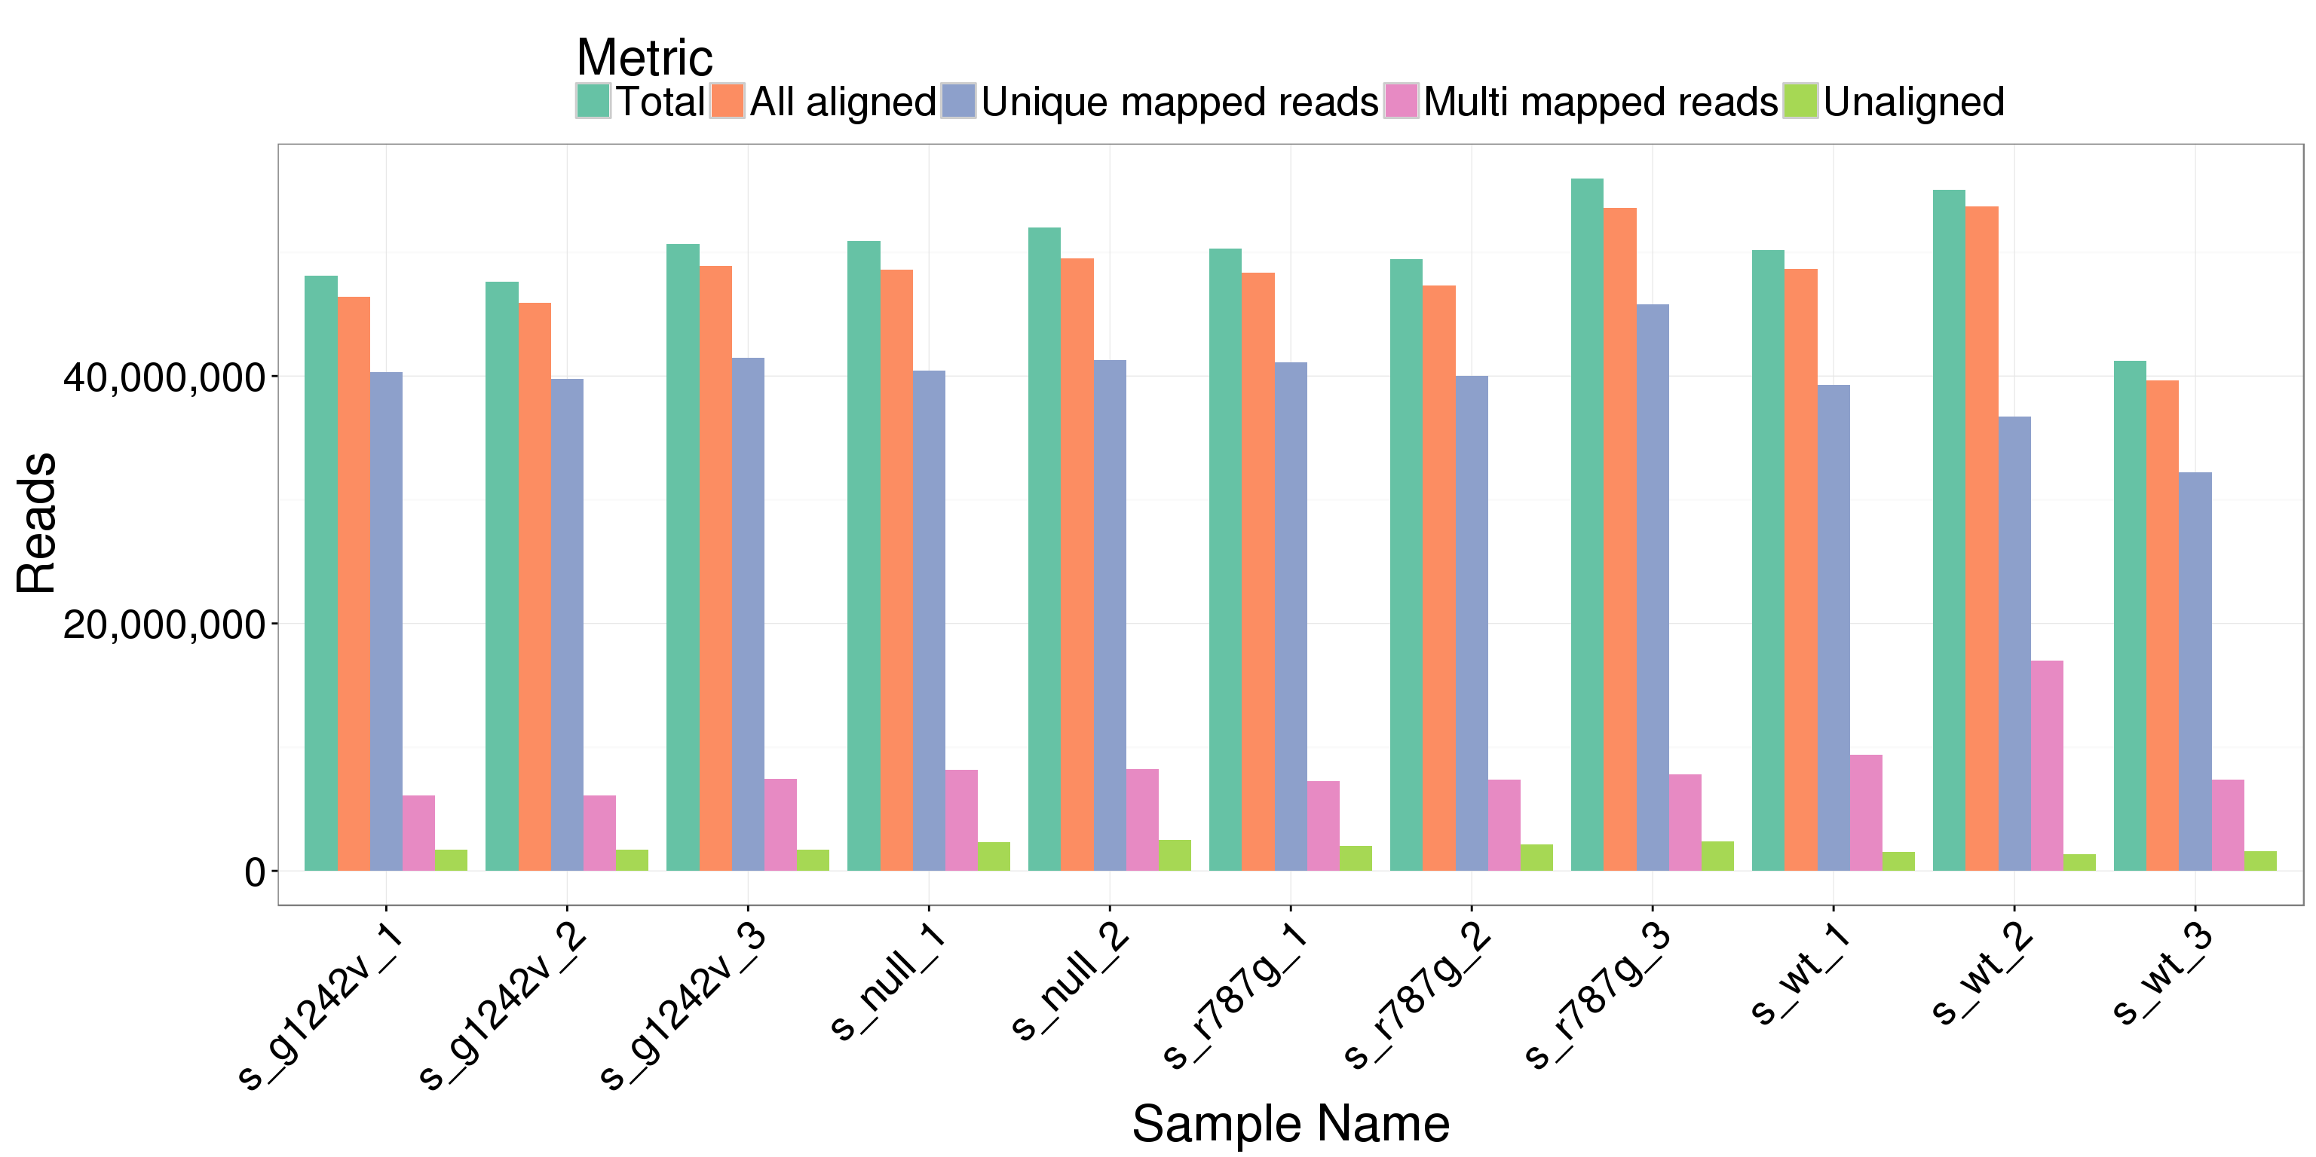
Internal Pipeline: Secundo

Slide 31
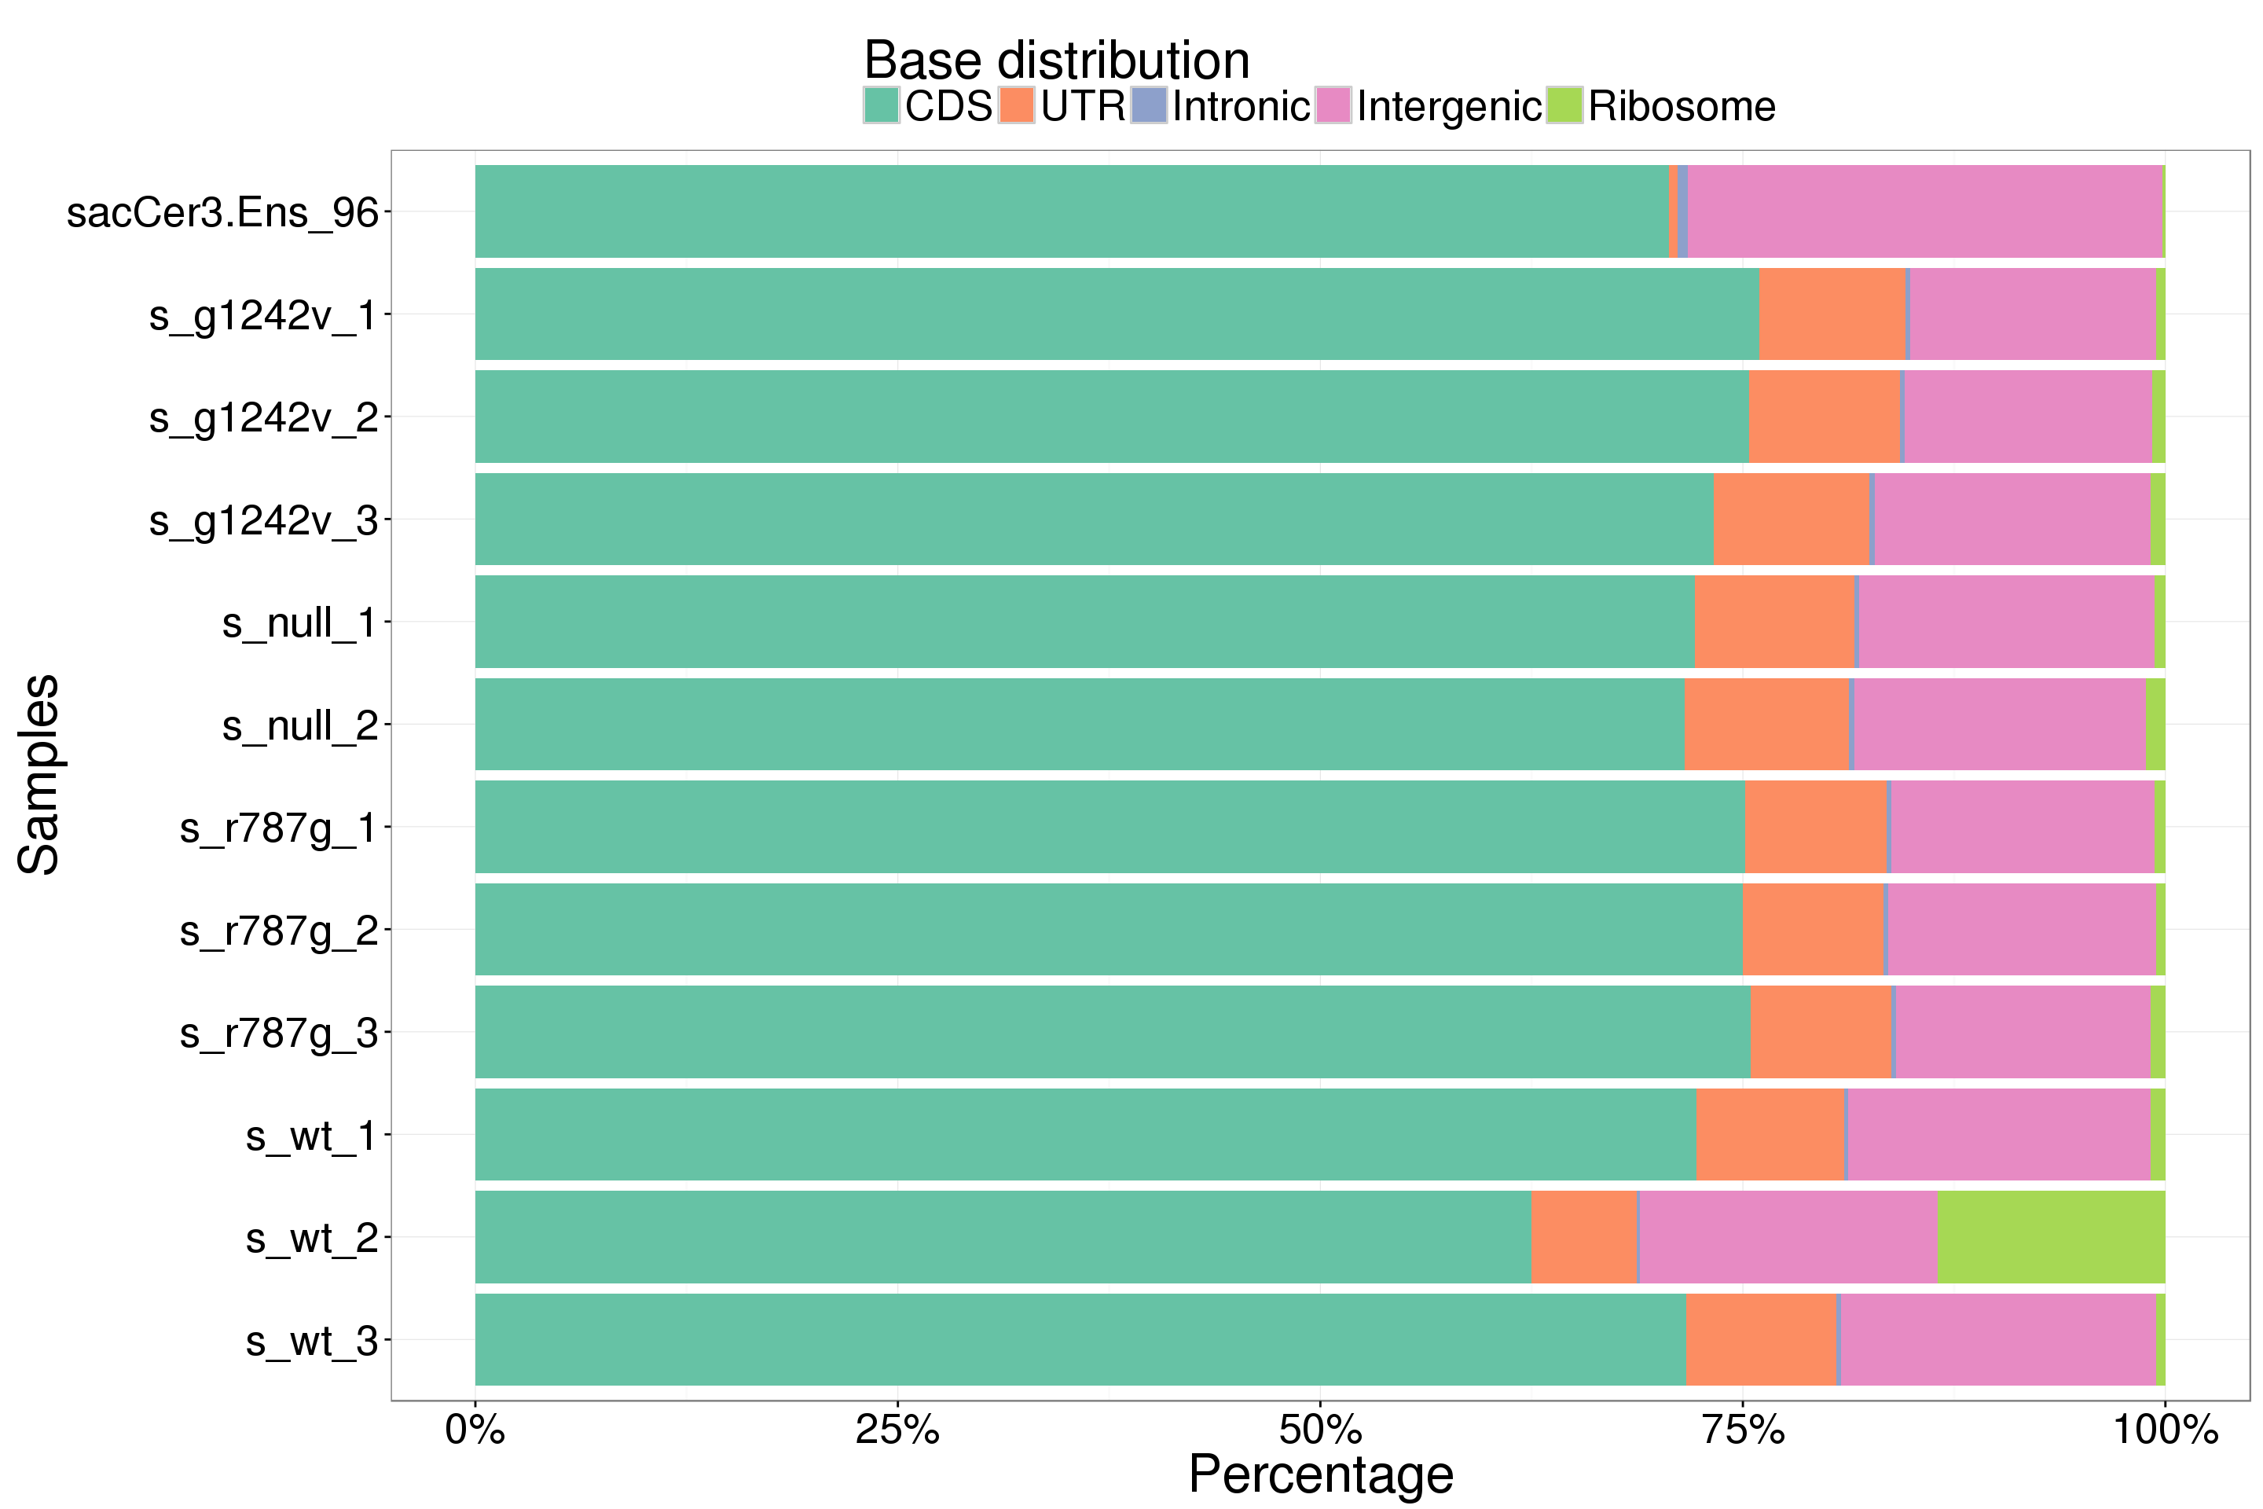
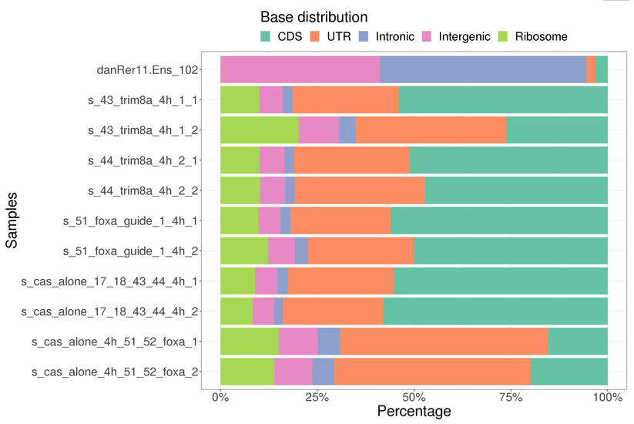
Internal Pipeline: Secundo

Slide 32
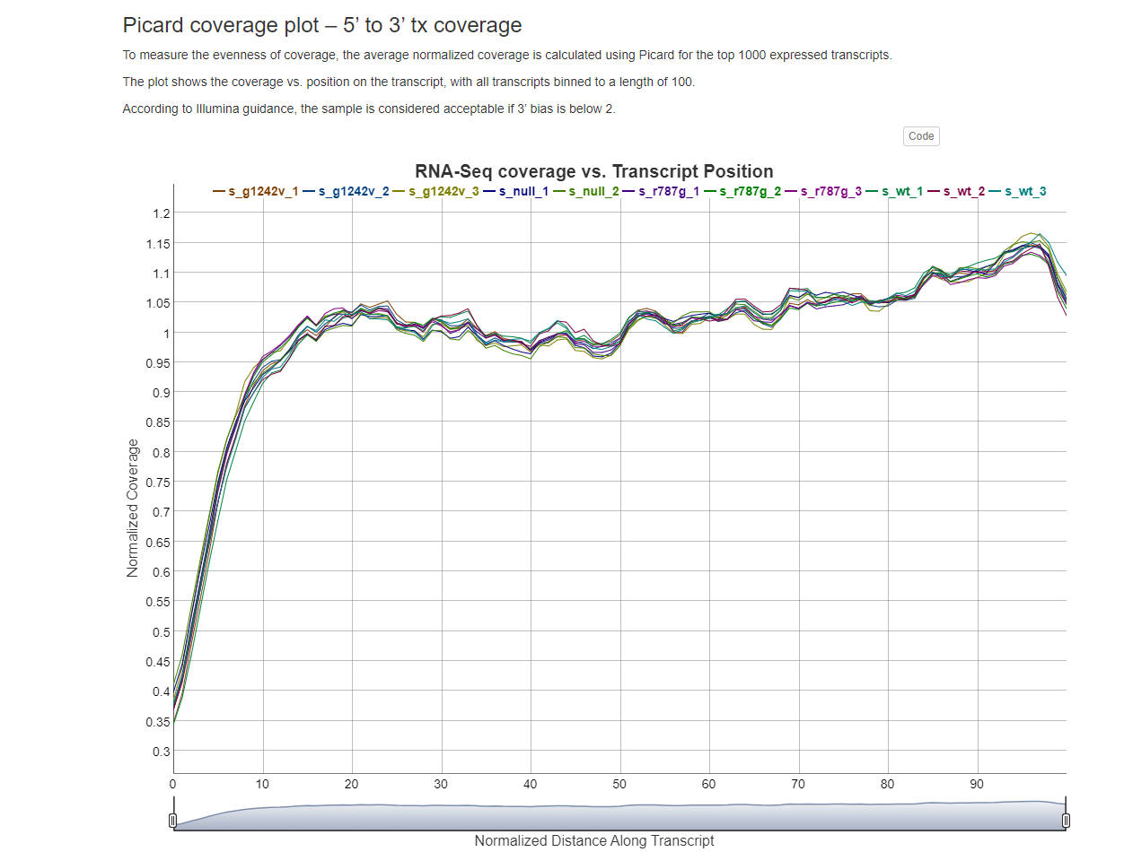

Internal Pipeline: Secundo

Slide 33
Applications: Single Cell Sequencing

Slide 34
Single Cell RNA-Seq, Things to Consider
Many single cell protocols available, some require capital equipment.
Clean single cell or nuclei suspensions are critical. Tissue dissociation can be tricky, and quality and quantity checks are a must.
Sometimes require cell straining and/or cell sorting.
Amount of sequencing needed will depend on number of cells/nuclei getting captured.
Critical to pay attention to the buffers that vendors recommend for resuspending cells. Vendors have specific guidelines, and it is important to know these.
Many vendor options based on researcher needs.
Do a pilot!

Slide 35
Single Cell Transcriptomics without 10X Genomics
Tube based scRNA-Seq
Fluent PIP-Seq Single Cell Analysis, RNA Sequencing (scRNA-Seq) | Fluent BioSciences
CS Genetics csgenetics
Honeycomb HIVE Honeycomb Biotechnologies, Inc. – Any cell. Any where. Any time.
Combinatory barcoding methods
Parse Biosciences Technology - Evercode™ Combinatorial Barcoding - Parse Biosciences
Scale Biosciences High-throughput Single Cell Sequencing | Scale Biosciences
Notes:
!!!!

Slide 36


10X Genomics

Slide 37



10X Genomics Single Cell RNA-seq
10X Genomics

Slide 38

10X Genomics Update: Fixed RNA Profiling (Human/Mouse)
Ability to fix and store cells/nuclei, minimize cell death & ease of shipping
Ability to process when time permits
Probe based
Detect low expressed genes and isoforms
Ability to multiplex

Slide 39

Multiple Labs

Slide 40


Nuclei Preparation
BIDMC TMC - low input single nuclei sequencing isolation (NNLB)
Luciano nuclei isolation methods in protocols.io

Slide 41

10X-Pacbio Kinnex scRNA-Seq

Slide 42
Spatial Transcriptomics, a hot New Topic

Slide 43
Spatial Transcriptomics
Sequencing based (unbiased, whole transcriptome)
Visium HD (10X Genomics)
Imaging based (with probe panels)
10X Genomics Xenium
Nanostring CosMx
Resolve
Vizgen
Rebus
Curio Seeker and Trekker (Curio Biosciences)
Akoya…
Stereo-Seq/STORM-Seq (Complete Genomics)

Slide 44


Tissue Sectioning with Histology
Arrangement of Planaria Tissue
Work with Histology to optimize tissue sectioning prior to any spatial transcriptomics project
10uM thick tissue is usually required
Fresh frozen tissue and/or FFPE compatible

Slide 45



Visium HD
2uM resolution
True single-cell spatial assay
Pre-designed probe sets against Human and Mouse transcriptomes
Human probe sets: ~18,000 genes
Mouse probe sets: ~19,000 genes
Some genes left out of probe sets (see links above)
FFPE tissue samples
New Fresh frozen protocol available as of Sept. 2024
Ideal for discovery-based projects
Researchers gain understanding of genes within their sample with spatial context
HD Products: Visium HD Spatial Gene Expression - 10x Genomics
10x Genomics

Slide 46



In-House Visium HD Example
H&E Stain Tissue
CytAssist Tissue Image
Mouse Brain sample from the Yu lab
>18,800 genes captured
98% mapped to probe set
High percentage of valid UMI and Barcodes (>88%)
High quality CytAssist and Microscope alignment
Spatial image correlates to H&E and CytAssist images as expected
UMAP successfully clusters 16+ unique cell types
Resulting Spatial Image and Clusters
Yu Lab

Slide 47




Curio Seeker
10uM resolution
Two tile sizes: 3x3mm and 10x10mm
Fresh frozen tissue, 10uM thick
No fixation can be used
Non-biased whole transcriptome assay
Utilizes mRNA capture
Ideal for discovery-based projects using non-model organisms
Researchers gain understanding of genes within their unique sample with spatial context
3x3 mm Tile
10x10 mm Tile
Workflow
Discover the Future of Spatial Omics with Curio Bioscience
Curio Biosciences

Slide 48






In-House Curio Seeker Examples
3x3 mm Tile Experiments
Mouse Fetal Liver
Liver Fluke
H&E-Stained Tissue
Resulting Spatial Image
H&E-Stained Tissue
Resulting Spatial Image
3x3mm Tiles: Mouse fetal liver (Li lab) and Liver fluke (Sanchez lab)
Over 90% reads matched to barcode
~170 median genes per bead for each sample
Total genes detected in mouse fetal liver: ~27,000
Total genes detected in Liver fluke: ~9,000
10x10mm Tile: Mouse tumor (Li lab)
Over 79% reads matched to barcode
~600 median genes per bead
Total genes detected: ~33,000
Li Lab
Sanchez Lab
10x10 mm Tile Experiments
Mouse Tumor Sample
H&E-Stained Tissue
Resulting Spatial Image
Li Lab

Slide 49





Curio Trekker
True single cell resolution
Nuclei tagged in spatial position before dissociation
10x10mm tile size
Fresh frozen tissue, 25uM thick
No fixation can be used
Non-biased whole transcriptome assay
Compatible with 10x Genomics Downstream protocols
scRNA-seq 3’ GEM-X (20K cells per reaction)
Multiome (scRNA-seq + ATAC)-not currently validated (10K reads per reaction)
10-20% of recovered nuclei is sufficient to see structures and cell interactions etc.
Ideal for discovery projects needing both spatial and single-cell data from the same tissue.
Curio Biosciences

Slide 50




Xenium by 10X Genomics
Pre-designed panels for human and mouse
Targeted probe-based approach to study genes of interest
At Stowers, we decided on Xenium due to the wide variety of organisms we work with
Imaging based in-situ assay with subcellular resolution
Supports Fresh Frozen or FFPE Tissue
Xenium Platform Page - 10x Genomics
https://youtu.be/8YF2ZMaV4V0

Slide 51
Overall Assay Comparisons
 | Curio Seeker | Curio Trekker | Visium HD | Xenium Analyzer
Platform Type | Sequencing Based | Sequencing Based | Sequencing Based | Imaging based
Assay Type | Whole Transcriptome | Whole Transcriptome | Targeted Whole Transcriptome | Targeted Gene Specific
Organisms Compatible | Any organism (poly-A based) | Any organism (nuclei tagging) | Human or Mouse | Human, Mouse, or Custom
Resolution | 10uM | Single cell level | 2uM | Sub-cellular
Transcripts Captured | Species dependent | Species dependent | 18-19K genes captured* | Pre-designed Panels: Up to 5000 genes (Human or Mouse) Add-on Panels: Up to 100 additional genes Standalone Custom Panel: Up to 480 genes
Capture Area Size | 3x3mm and 10x10mm tiles | 10x10mm tiles | 6.5 x 6.5mm, two capture areas per slide processed for each project | 11x22mm capture area per slide, two slides processed per project
Base Pricing** | 3x3mm: $1,400 + sequencing 10x10mm: $3,500 + sequencing | $2,500 +10x Genomics Assay cost and sequencing | ~$6,200 + sequencing costs | ~$7,000-10,000
*Some genes excluded from whole transcriptome probe set. See 10x Genomics site for details.
**Pricing will vary based of the experimental needs, size of Curio tiles, and if custom probes for Xenium were used. Please see full price breakdown for assays in the next few slides.

Slide 52
Curio Trekker Cross-Core Workflow
Color Key
 | Multiple Groups
 | Histology
 | S&DG
 | CompBio
Plan and Optimize
Real Experiment
Project Planning Meeting
Tissue Sectioning Pilot with Histology team
Schedule Training Run to test nuclei dissociation
Training Run
Tissue sectioning and placement of sample on Tile by Histology
Training Run
UV Cleavage
Tissue Clearing
Nuclei Dissociation
Nuclei Count
Scheduling of Real Project
Tissue sectioning and placement of sample on Tile by Histology
UV Cleavage
Tissue Clearing
Nuclei Dissociation
Nuclei Count
10X Genomics scRNA-seq
Or Multiome
NGS Library Prep
Sequencing
Primary Analysis

Slide 53
Final Thoughts…
Garbage in, garbage out.
Performing quality checks during wetlab and pre- indepth analysis is critical in order to not waste time.
Reach out for assistance.
If your institute cannot support the type of applications you need, consider outsourcing. Many academic institutes accept outside samples for many application types and sequencing.

